Slide 1
CEGE0004: Machine Learning for Data Science Lecture 5: Neural Networks Dr. Aldo Lipani

Slide 2
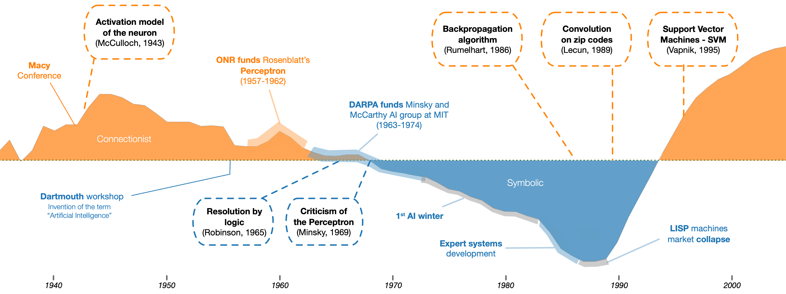
Connectionism
It is an approach that hopes to explain mental phenomena using artificial neural networks (ANN).
The success of deep learning in the past decade has greatly increased the popularity of this approach.

Slide 3

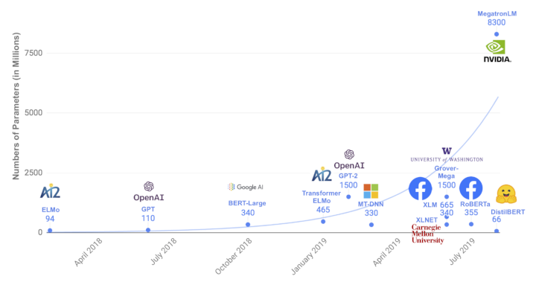
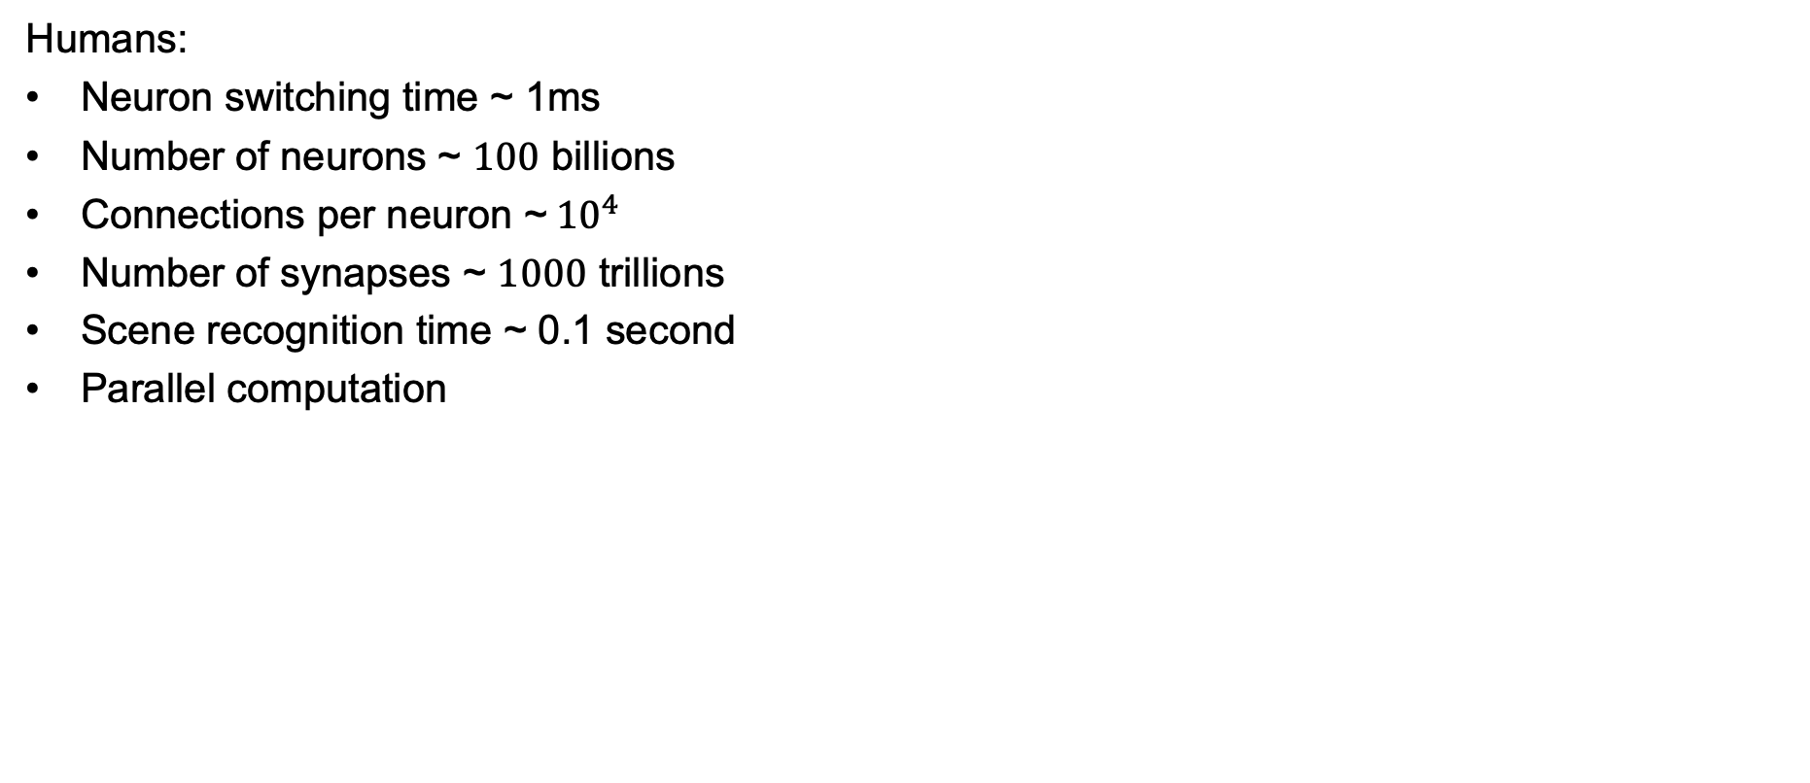
Connectionist Models
Humans:
Neuron switching time ~ 1ms
Number of neurons ~ $100$ billions
Connections per neuron ~${10}^{4}$
Number of synapses ~ $1000$ trillions
Scene recognition time ~ 0.1 second
Parallel computation
Neural nets:
Transistor switching time ~ 1 ns
Parallel process
Largest machine learning model in 2020:
Generative Pre-trained Transformer 3 (GPT-3)
Number of parameters ~ 175 billions

Slide 4

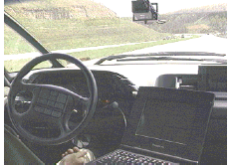
Neural Networks Applications

Slide 5
Neural Networks Applications
Machine Translation

Slide 6
Neural Networks Applications
Speech recognition

Slide 7
Neural Networks Applications
Automatic Road Detection and Cityscape Detection

Slide 8
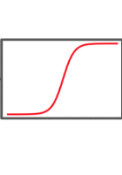
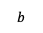
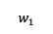
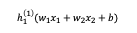
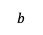
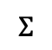
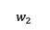
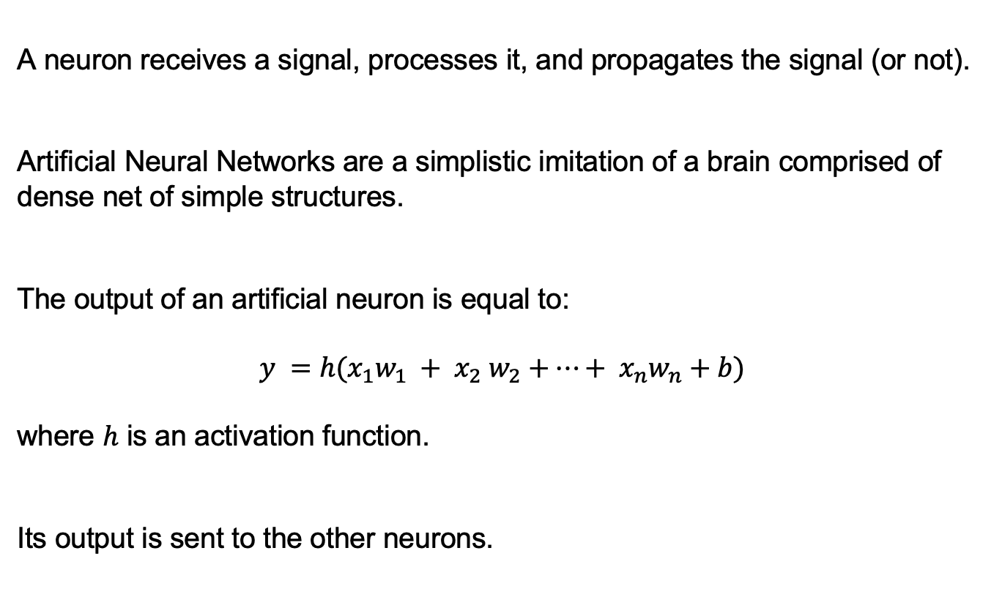
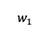
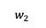
Artificial Neural Networks
A neuron receives a signal, processes it, and propagates the signal (or not).
Artificial Neural Networks are a simplistic imitation of a brain comprised of dense net of simple structures.
The output of an artificial neuron is equal to:
$$y =h(x_{1}w_{1} + x_{2} w_{2}+…+ x_{n}w_{n}+b)$$
where $h$ is an activation function.
Its output is sent to the other neurons.
$$b$$
$$w_{1}$$
$$h_{1}^{\left(1\right)}(w_{1}x_{1}+w_{2}x_{2}+b)$$
$$w_{2}$$
$$b$$
$$w_{1}$$
$$Σ$$
$$w_{2}$$

Slide 9
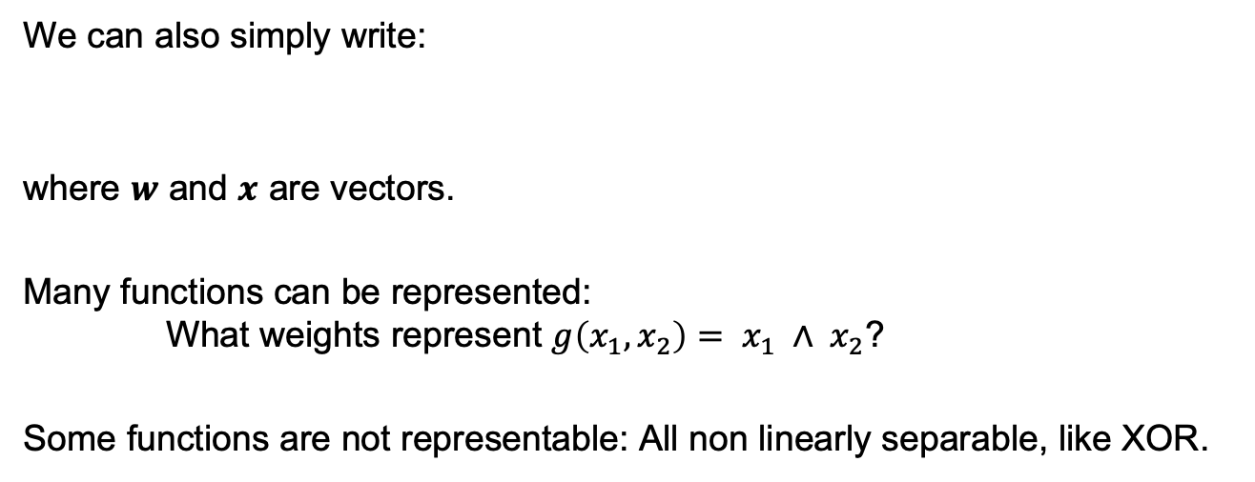
Perceptron
We can also simply write:
where $w$ and $x$ are vectors.
Many functions can be represented: What weights represent $g\left(x_{1}, x_{2}\right)= x_{1} ∧ x_{2}$?
Some functions are not representable: All non linearly separable, like XOR.

Slide 10
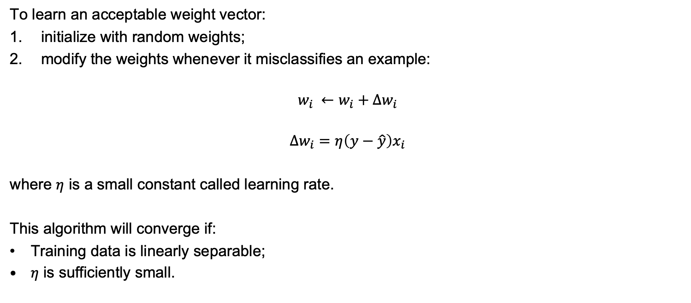
Perceptron Training Rule
To learn an acceptable weight vector:
initialize with random weights;
modify the weights whenever it misclassifies an example:
$$w_{i} ←w_{i}+∆w_{i}$$
$$∆w_{i}=η\left(y−\hat{y}\right)x_{i}$$
where $η$ is a small constant called learning rate.
This algorithm will converge if:
Training data is linearly separable;
$η$ is sufficiently small.

Slide 11
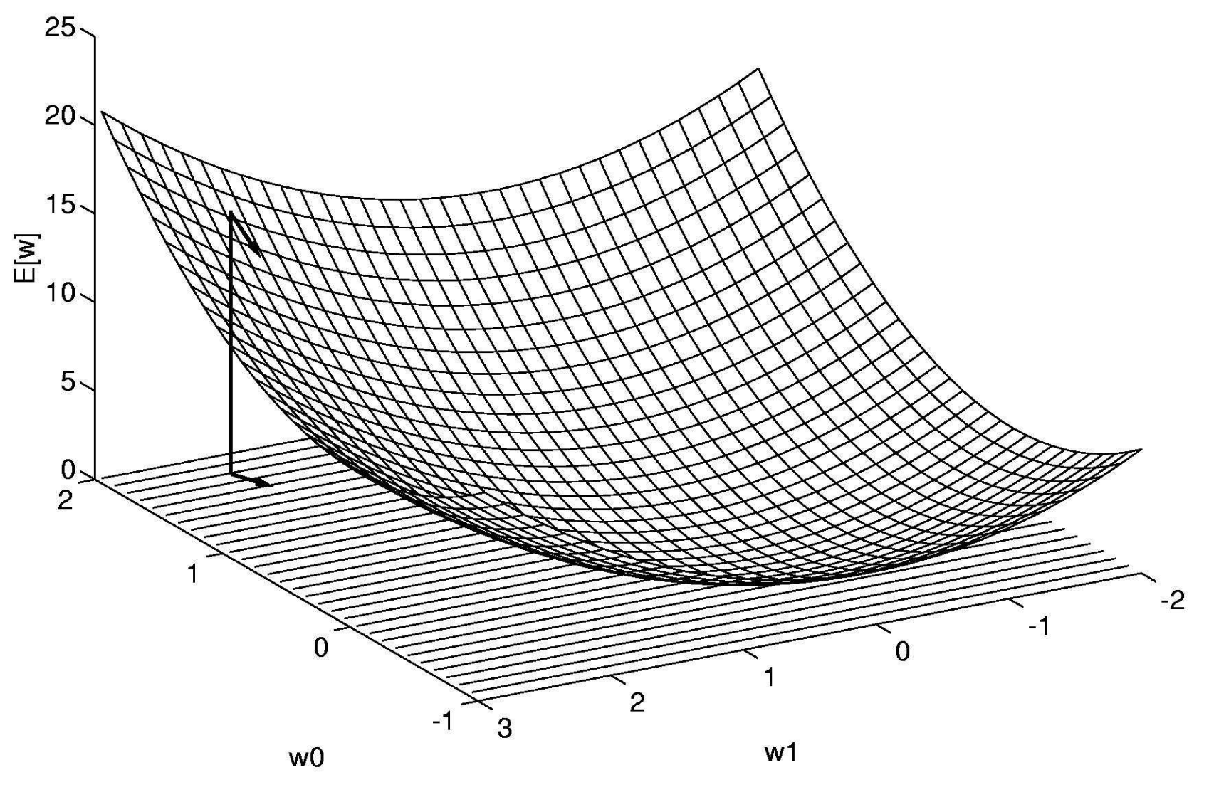
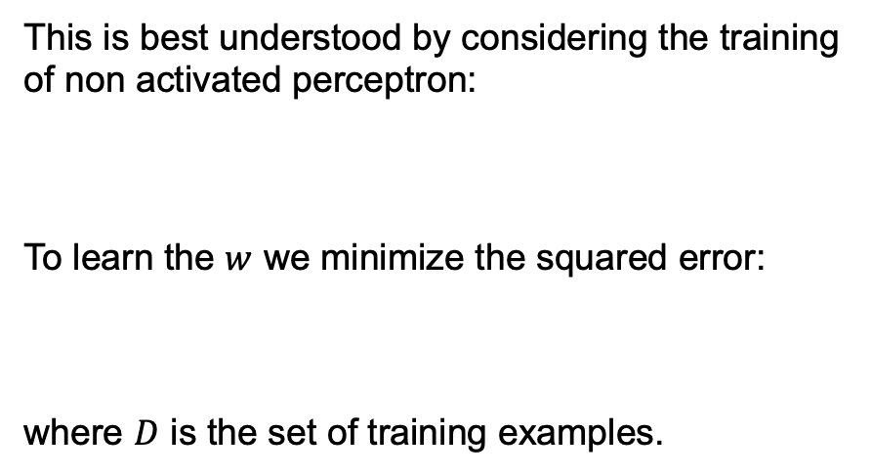
Gradient Descent
When the training examples are not linearly separable, the previous algorithm does not converge. To avoid this issue, the key idea is to use gradient descent to search the hypothesis space.
This is best understood by considering the training of non activated perceptron:
To learn the $w$ we minimize the squared error:
where $D$ is the set of training examples.

Slide 12
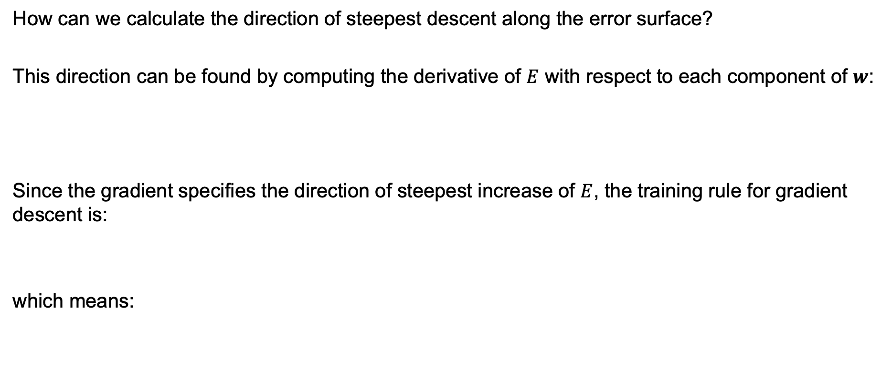
Derivation of the Gradient Descent Rule
How can we calculate the direction of steepest descent along the error surface?
This direction can be found by computing the derivative of $E$ with respect to each component of $w$:
Since the gradient specifies the direction of steepest increase of $E$, the training rule for gradient descent is:
which means:

Slide 13
Derivation of the Gradient Descent Rule
Linear perceptron (no activation):
Error:
We need now to calculate the gradient:
We now compute the partial derivatives:

Slide 14
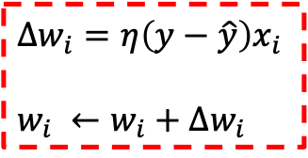
Gradient Descent
def gradient_descent(xs, ys, eta, epochs): n_features = xs.shape[1] ws = np.random.random(n_features)/100 # initialize weights to a small random value for _ in range(epochs): # termination condition delta_ws = np.zeros(n_features) # initialize delta weights to zero for x, y in zip(xs, ys): # iterate trough the training data hat_y = 2 * (ws @ x > 0) – 1 # perceptron delta_ws = delta_ws + eta*(y - hat_y)*x
ws = ws + delta_ws # update weights return ws
$∆w_{i}=η\left(y−\hat{y}\right)x_{i}$
$w_{i} ←w_{i}+∆w_{i}$

Slide 15
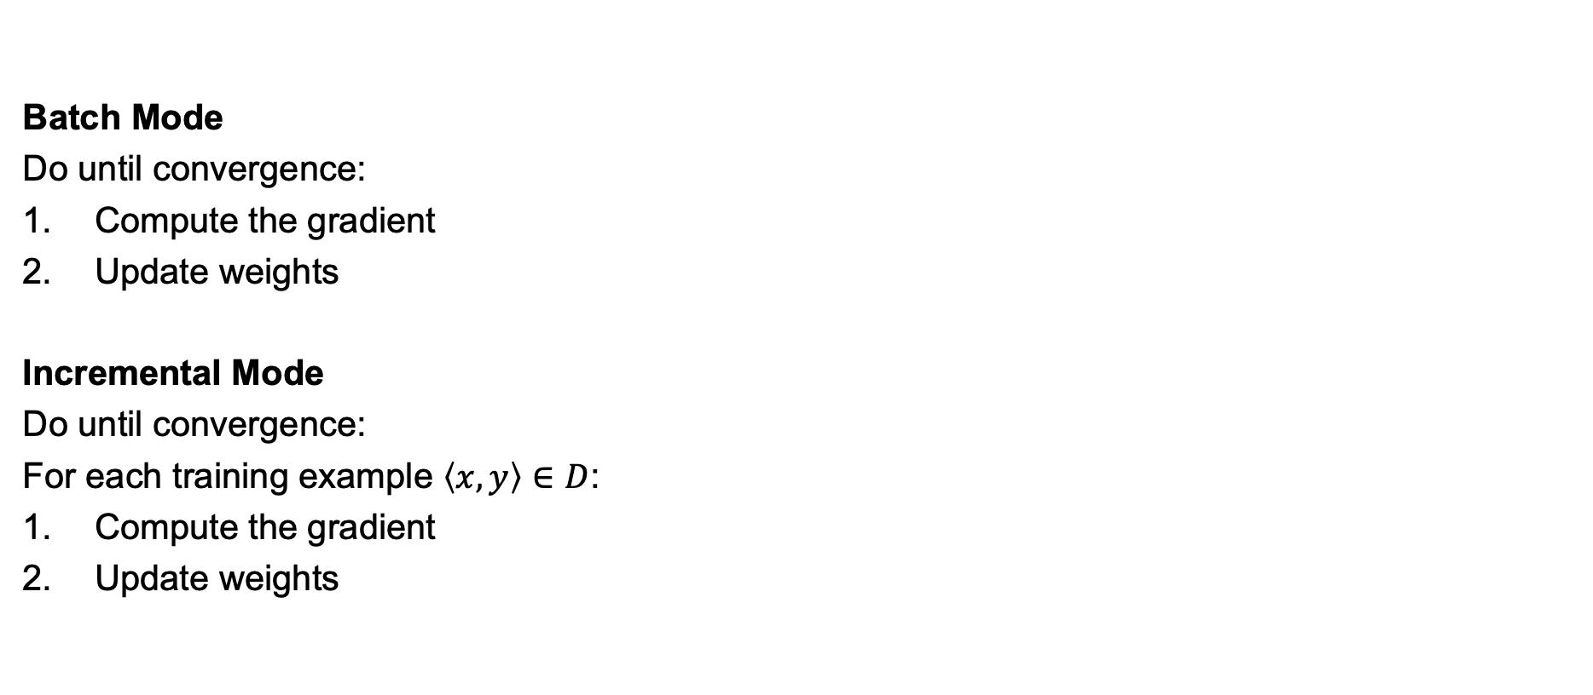
Batch vs. Incremental Gradient Descent
Batch Mode
Do until convergence:
Compute the gradient
Update weights
Incremental Mode
Do until convergence:
For each training example $\left\langle x,y\right\rangle ∈D$:
Compute the gradient
Update weights

Slide 16
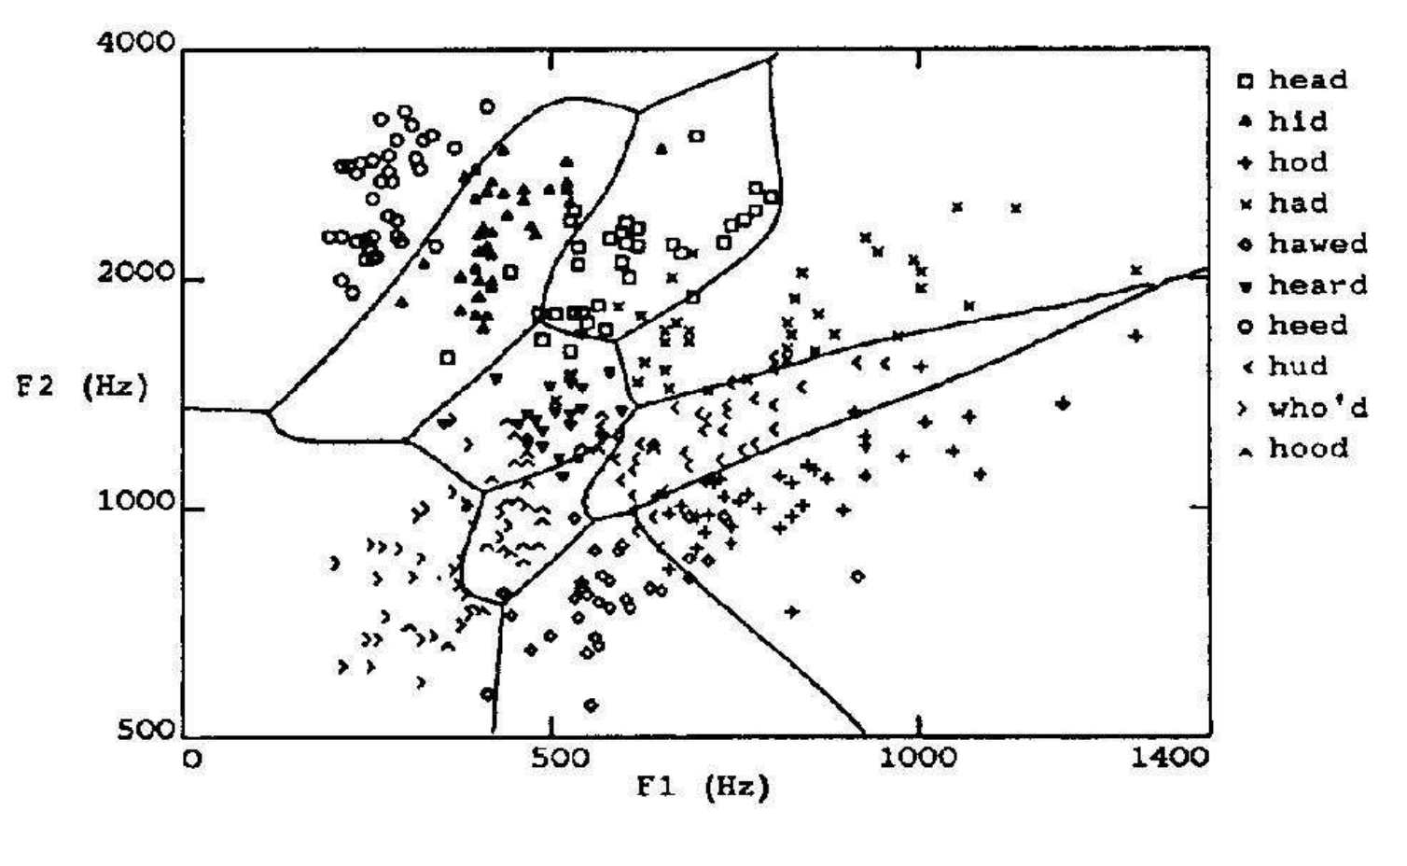
Multilayer Networks

Slide 17
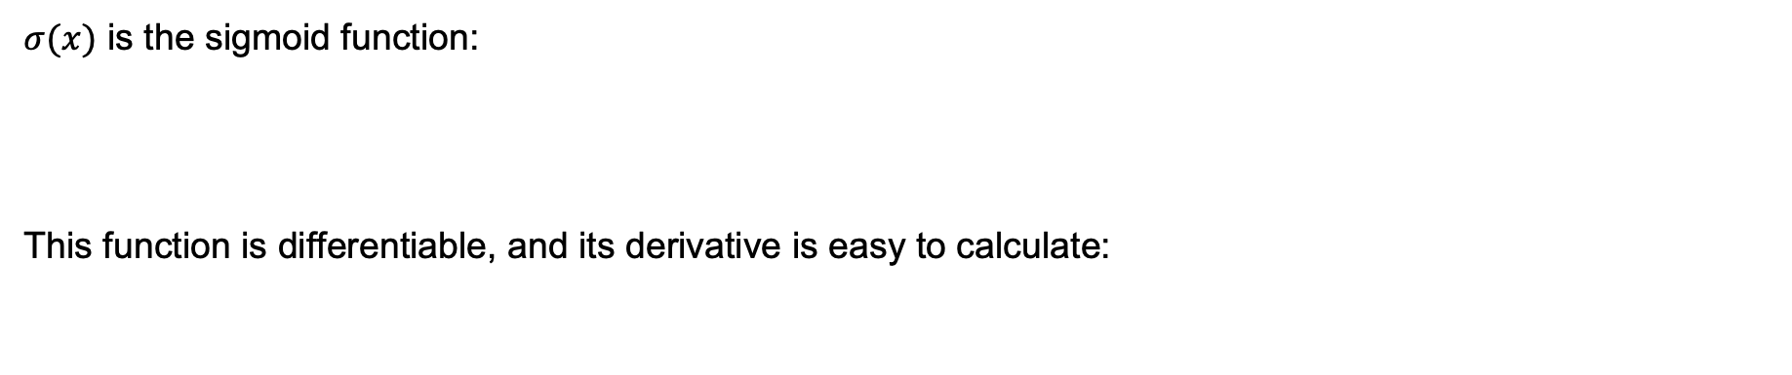
Sigmoid Unit
$σ(x)$ is the sigmoid function:
This function is differentiable, and its derivative is easy to calculate:

Slide 18
Derivation of the Gradient Descent Rule for a Sigmoid Unit
Sigmoid unit:
Error:
We need now to calculate the gradient:
We now compute the partial derivatives:

Slide 19
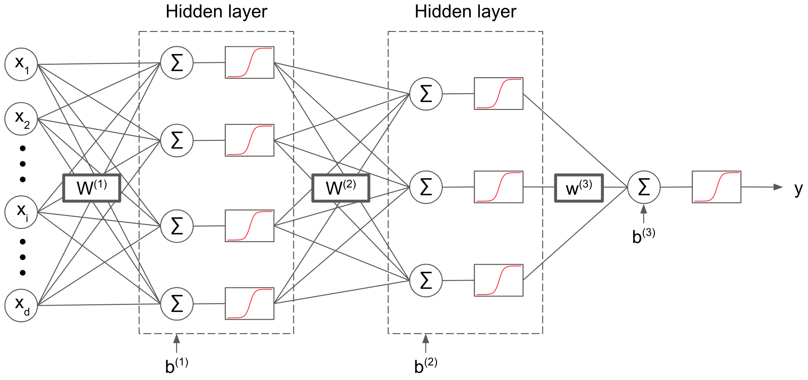
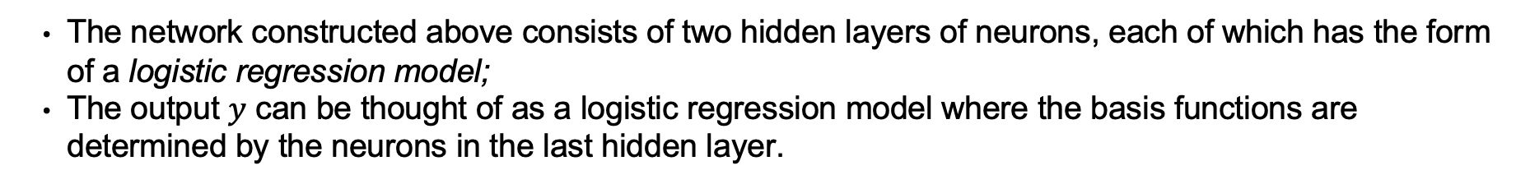
Concept Learning with a Multilayer Network
remove this activation to get a regression model
The network constructed above consists of two hidden layers of neurons, each of which has the form of a logistic regression model;
The output $y$ can be thought of as a logistic regression model where the basis functions are determined by the neurons in the last hidden layer.

Slide 20
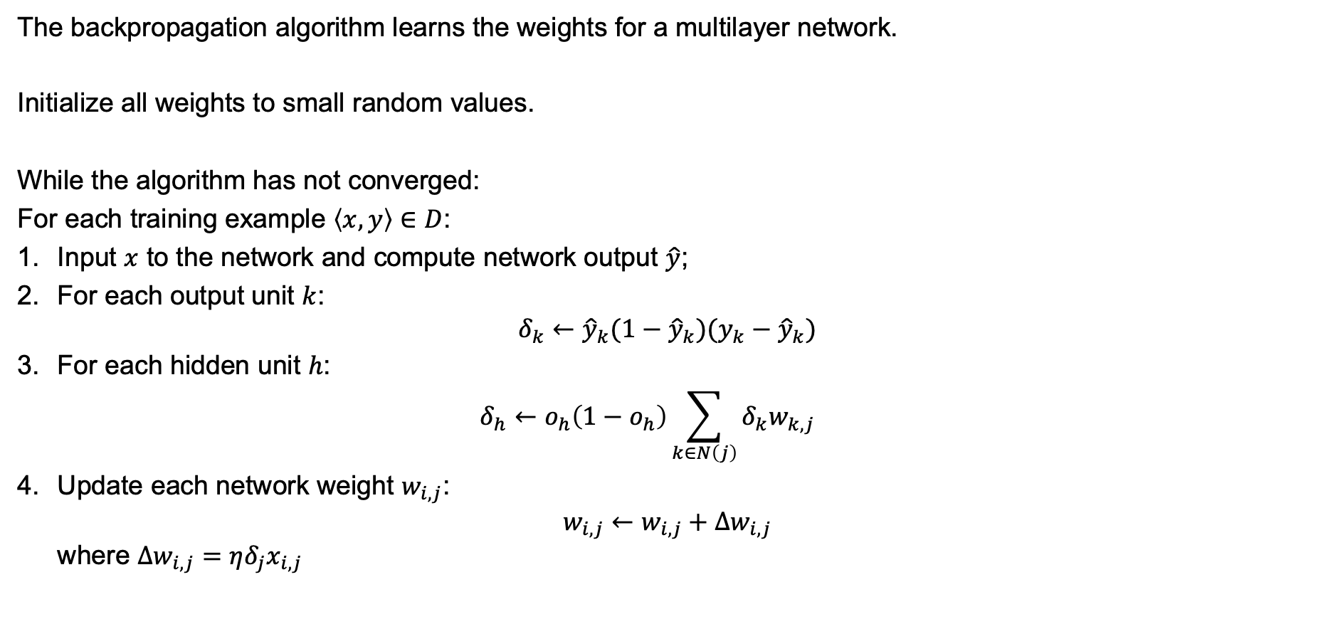
The Backpropagation Algorithm
The backpropagation algorithm learns the weights for a multilayer network.
Initialize all weights to small random values.
While the algorithm has not converged:
For each training example $\left\langle x, y\right\rangle ∈D$:
Input $x$ to the network and compute network output $\hat{y}$;
For each output unit $k$: $δ_{k}←{\hat{y}}_{k}(1−{\hat{y}}_{k})(y_{k}−{\hat{y}}_{k})$
For each hidden unit $h$: $δ_{h}←o_{h}\left(1−o_{h}\right)\sum_{k∈N\left(j\right)}{δ_{k}w_{k,j}}$
Update each network weight $w_{i,j}$: $w_{i,j}←w_{i,j}+∆w_{i,j}$ where $∆w_{i,j}=ηδ_{j}x_{i,j}$

Slide 21
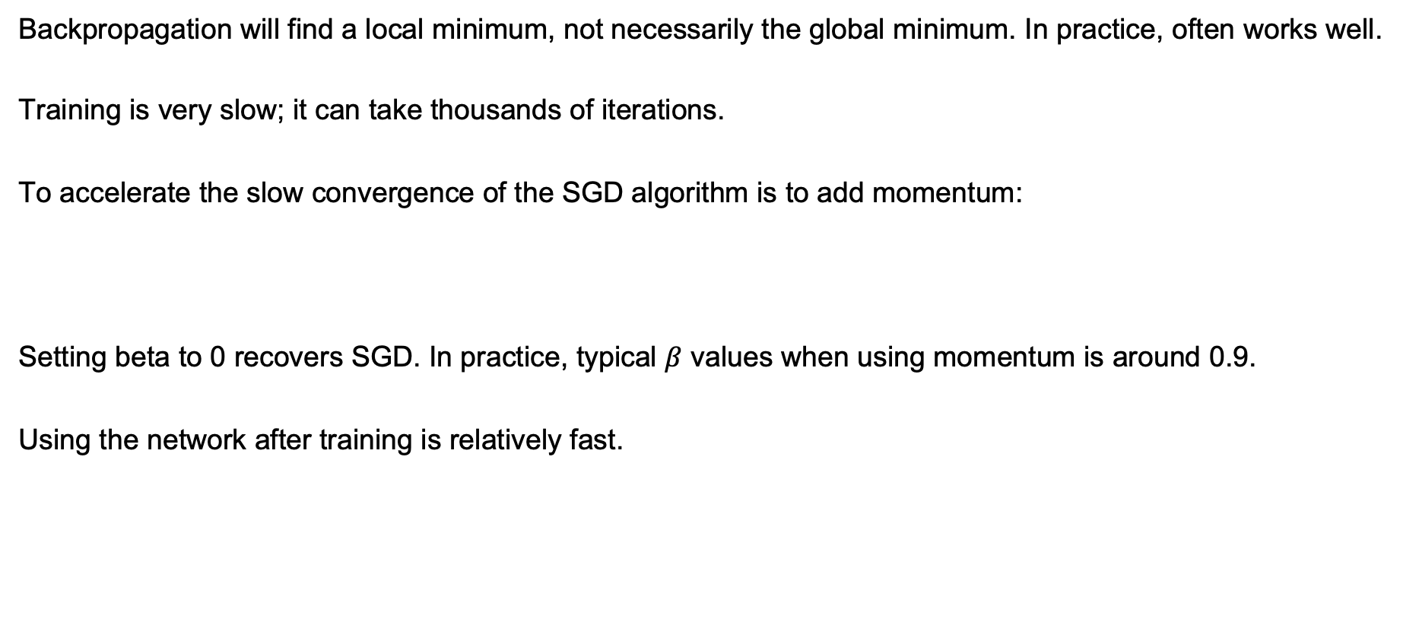
Backprogation Algorithm
Backpropagation will find a local minimum, not necessarily the global minimum. In practice, often works well.
Training is very slow; it can take thousands of iterations.
To accelerate the slow convergence of the SGD algorithm is to add momentum:
Setting beta to 0 recovers SGD. In practice, typical $β$ values when using momentum is around 0.9.
Using the network after training is relatively fast.

Slide 22
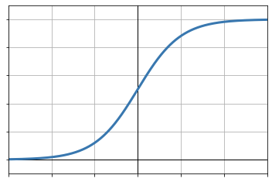
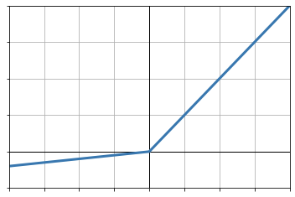
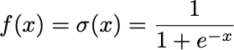
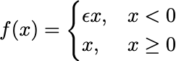
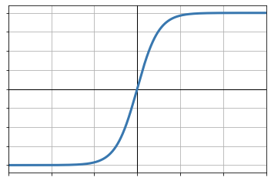
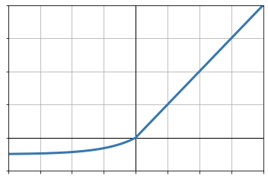
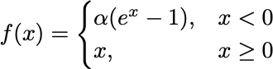
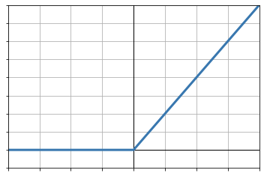
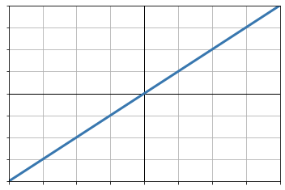
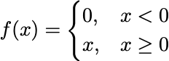
Activation Functions
sigmoid
leaky ReLU
tanh
ELU
ReLU
identity

Slide 23
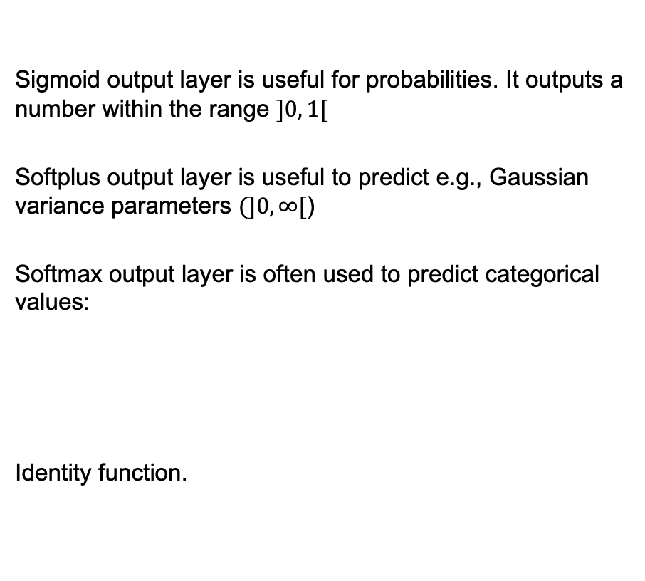
Output Layers
Sigmoid output layer is useful for probabilities. It outputs a number within the range $]0, 1[$
Softplus output layer is useful to predict e.g., Gaussian variance parameters $(]0, ∞[$)
Softmax output layer is often used to predict categorical values:
Identity function.

Slide 24
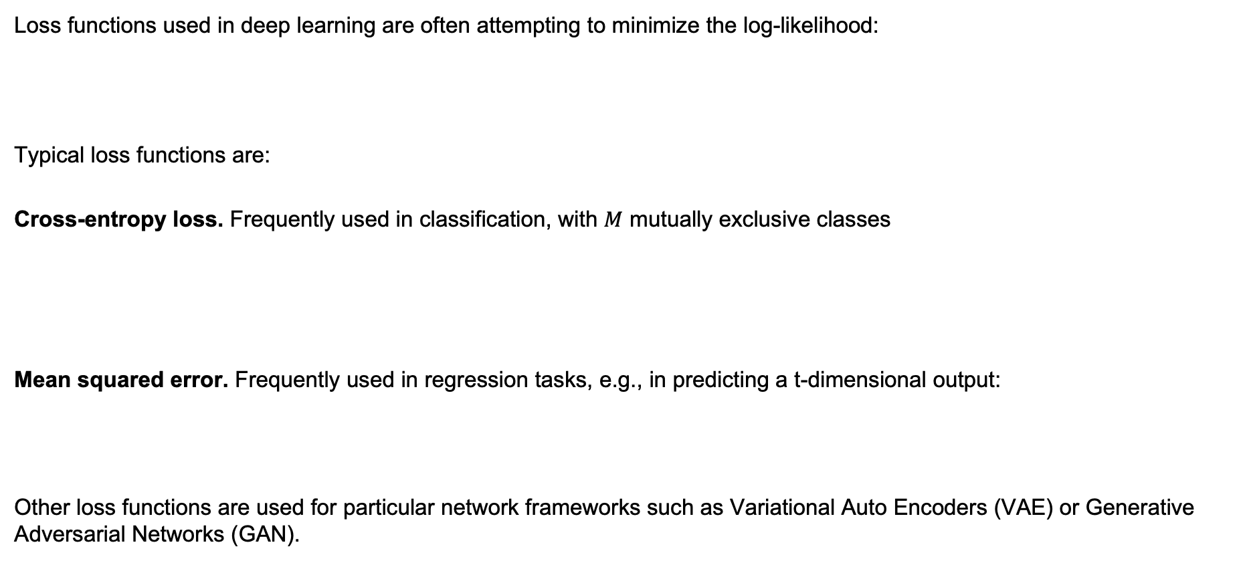
Loss functions
Loss functions used in deep learning are often attempting to minimize the log-likelihood:
Typical loss functions are:
Cross-entropy loss. Frequently used in classification, with $M$ mutually exclusive classes
Mean squared error. Frequently used in regression tasks, e.g., in predicting a t-dimensional output:
Other loss functions are used for particular network frameworks such as Variational Auto Encoders (VAE) or Generative Adversarial Networks (GAN).

Slide 25
Learning Hidden Layer Representations
These are also known as autoencoders.
Learn an efficient data coding in an unsupervised manner.
It is constituted by two main parts: an encoder that maps the input into the code, and a decoder that maps the code to a reconstruction of the original input.
The aim of an autoencoder is to learn a representation (encoding) for a set of data, typically for dimensionality reduction.

Slide 26
Overfitting vs. Underfitting

Slide 27
A Recipe to Train a Supervised Model
Pre-processing data, normalize your data;
Start with a simple model but…
To avoid underfitting make your model more complex;
To avoid overfitting split the data in train set, validation set and test set;
Train your model on the train set
Select your best model based on the validation set (including hyper-parameters)
Report results on the test set

Slide 28
A Recipe to Train a Supervised Model
When training you will iterate over the dataset a number of times, one dataset iteration is called an epoch.
Error

Slide 29
Regularization
Regularization is important to avoid overfitting.
There are several approaches to regularization in deep learning:
Model complexity
Weight decay
Early stopping
Dropout
Weight sharing (as in CNN)
Ensemble predictions
Dataset augmentation
Multitask learning
Adversarial training

Slide 30
Summary
Perceptrons
Sigmoid Units
Multilayer networks
Backpropagation
Autoencoders
Training a neural network

